Slide 1


Data Analytics
‘Social Buzz’

Slide 2


Today's agenda
Project Recap
An analysis of Social Buzz content categories that highlights the top 5 categories with the largest aggregate popularity
Problem
We will delve deeper into the issues that the analytics team has been working and shed some lights on why is this an issue.
The Analytics Team
Outlining the issues with the team and answering the guiding questions to get the insights
Process
Going through the general steps of Extract, Load, Transform, Analyze and Act on the provided datasets
Insights & Summary
Reviewing the insights and findings, building visualizations, and sharing with the stakeholders.

Slide 3

‘Social Buzz’ is a rapidly expanding unicorn in the technology space that needs to quickly adjust to its global reach.
Accenture has started working as a solution provider in the following areas:
Examining Social Buzz’s use and management of Big Data
Strategies to roll out an initial public offering (IPO)
Determining the Top 5 content categories of Social Buzz
Project Recap

Slide 4

Problems
‘Social Buzz’ has a rapidly expanded to an enormous
extent and they lack the resources to manage it
Every day. Social Buzz receives over 100,000 posts totaling 36,500,000 posts annually. Since the content is unstructured it might be challenging to make sense at at all.
Determine the specifications that must be fulfilled for the project
Combining tables from the sample dataset.
An analysis of their content categories that identifies the top 5 with the highest total popularity

Slide 5

Manoj Das Data Analyst
The Analytics team

Slide 6
Process
Understanding Data
1
Data Cleaning
2
Data Modelling
3
Data Analysis
4
5
Uncover Insights

Slide 7
Cleaning the data:
Removing rows that have values which are missing,
Changing the data type of some values within a column, and
Removing columns which are not relevant to this task.
Cleaning Dataset: Content.csv
1. Deleted column URL
2. Deleted column User ID
3. Removed " from column Category
4. Rename column Type to Content_Type

Slide 8
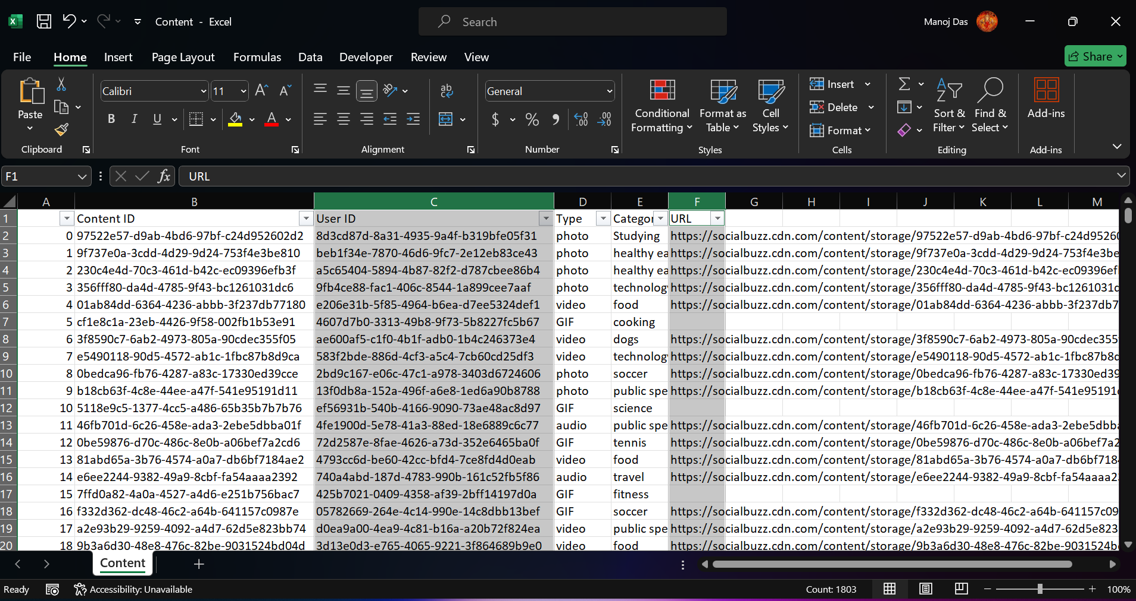
1. Deleted columns User ID and URL

Slide 9
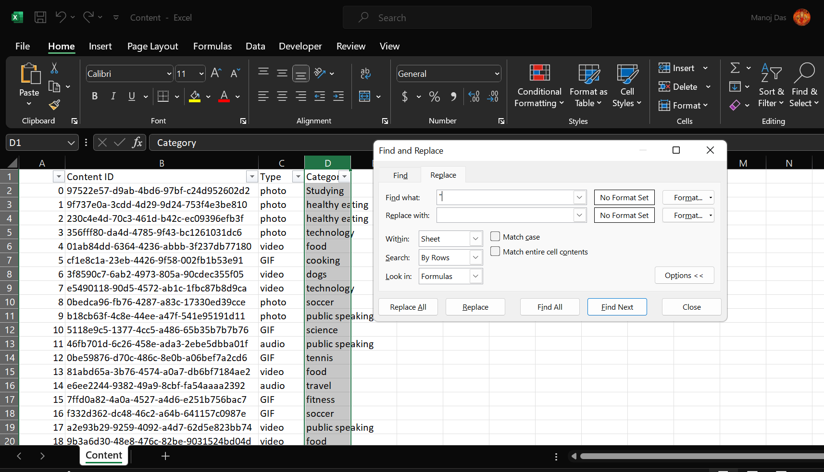
2. Removed " from column Category

Slide 10
Cleaning Dataset: Reaction.csv
1. Deleted column User ID
2. Deleted blank value rows from column Type
3. Rename column Type to Reaction_Type

Slide 11
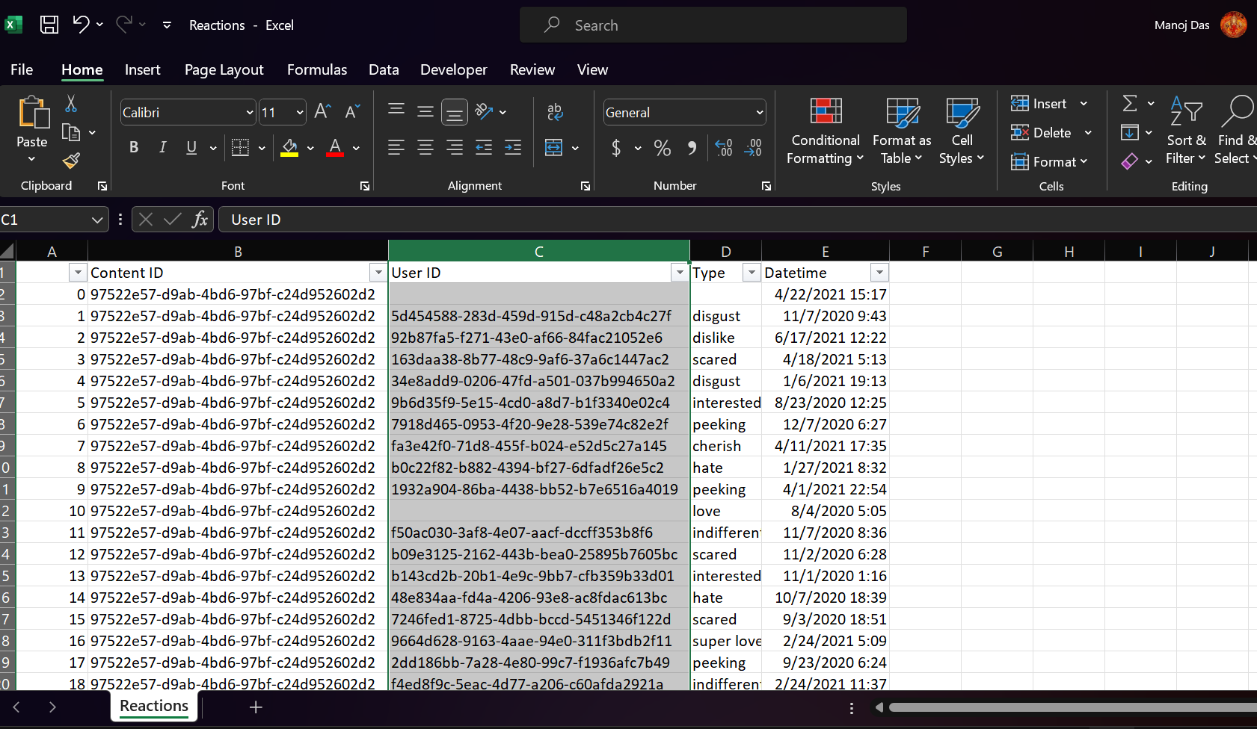
1. Deleted column User ID

Slide 12
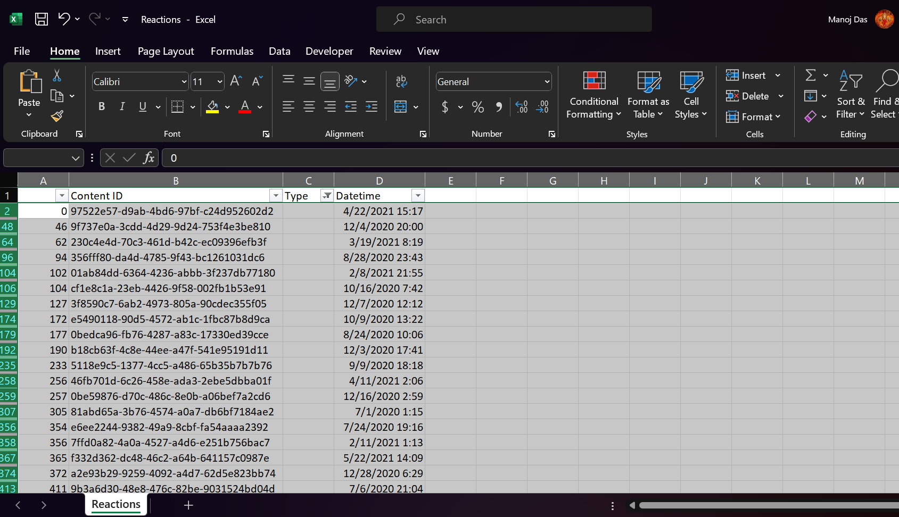
2. Deleted blank value rows from column Type

Slide 13
Transforming and Modelling the Data:
1. Using Reaction.csv as the base file & saving it as Reaction.xlsx
2. Creating Content_Type & Category columns from Content.csv
3. Creating Sentiment & Score columns from ReactionTypes.csv
4. Merging data from Content.csv & ReactionTypes.csv to Reaction.xlsx using VLOOKUP
5. Copy Category column to new sheet
6. Removing duplicates from Category column
7. Use SUMIF to get total score for each categories
8. Sort the Score column in descending order and copy the Top 5 rows
9. Paste in new sheet and name it Top_5_Categories

Slide 14
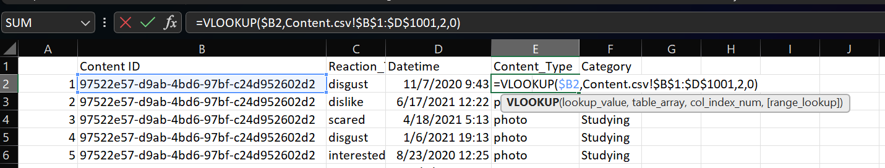
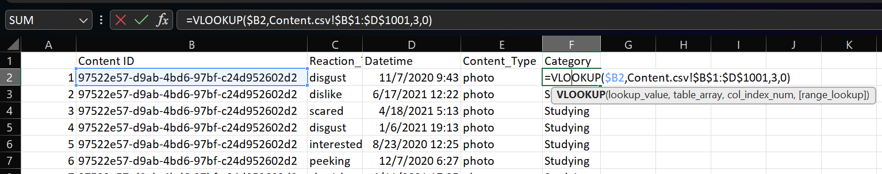
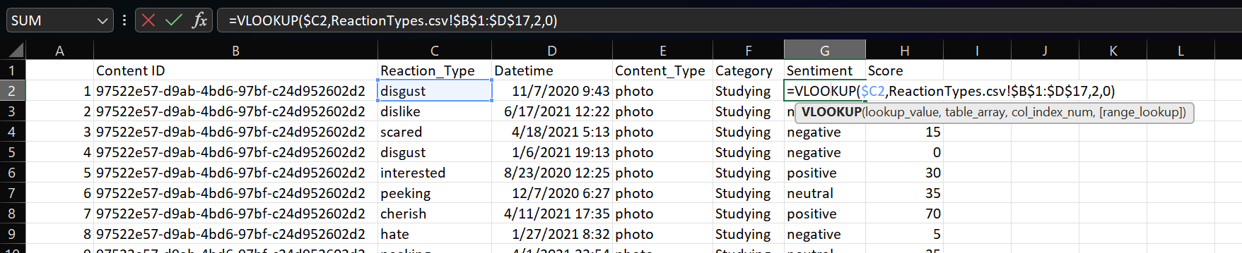
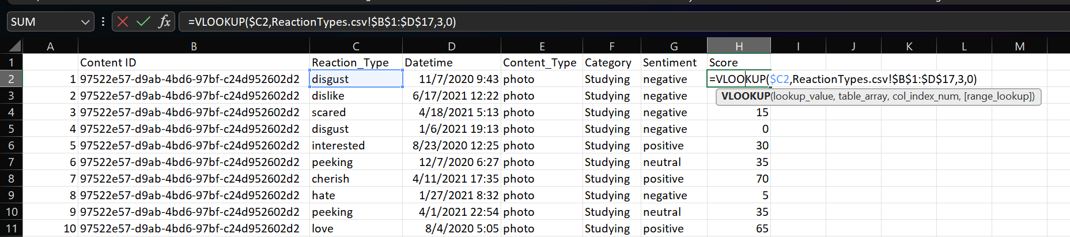
Creating Cleaned Dataset:
Merging data from Content.csv & ReactionTypes.csv to Reaction.xlsx using VLOOKUP

Slide 15
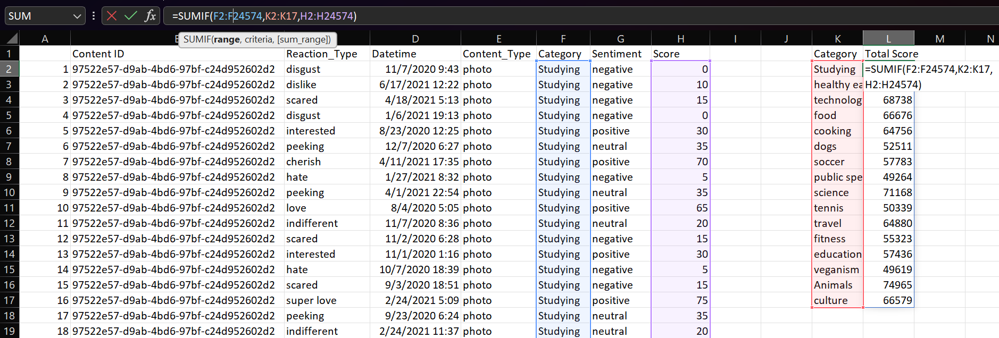
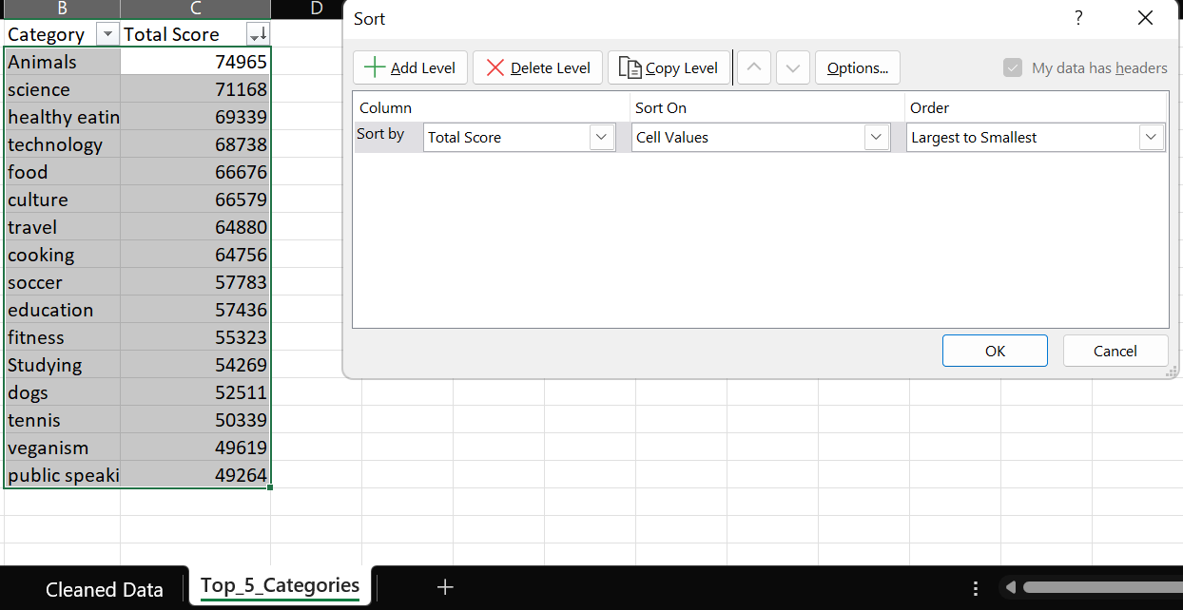
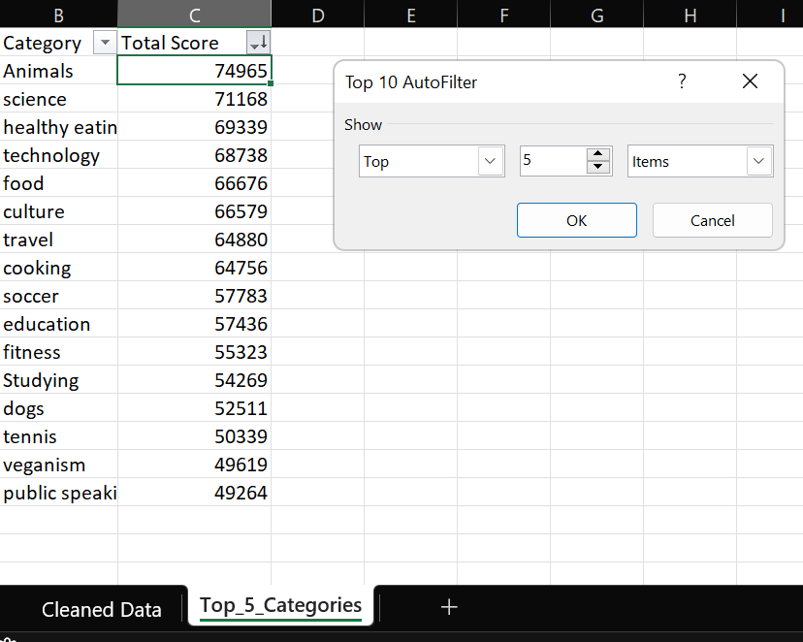
Removing duplicates from Category column
Use SUMIF to get total score for each categories
Sort the Score column in descending order and copy the Top 5 rows
Paste in new sheet and name it Top_5_Categories

Slide 16

Insights
Category with Highest Score
Month with Most Posts
Unique Categories
Animals
16
75K
May

Slide 17
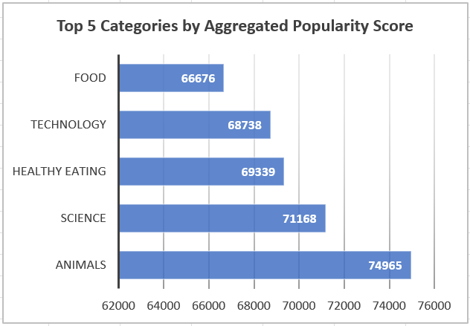

Slide 18
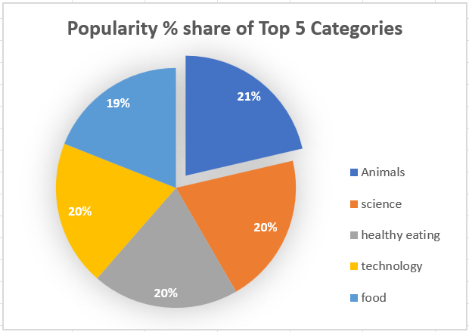

Slide 19

Analysis
Animals and Science are two of the most popular content categories this shows that people enjoy ‘real life’ and 'factual’ content the most. So I would recommend that you keep creating more contents relating to these two categories.
Food is a common theme with the top 5 categories with ’Healthy Eating' ranking as one of the highest. This may give an indication to the audience within your user base You could use this might to create a campaign and work with healthy eating brands to boost user engagement.
It should come as no surprise that technological content is among the top categories given the advancement of technology. It indicates the users like your technological material. Working with some of the biggest digital companies in the world is something I would suggest doing because it would undoubtedly increase user engagement.
Insight
Summary
Next Steps

Slide 20
Thank you!

